Slide 1
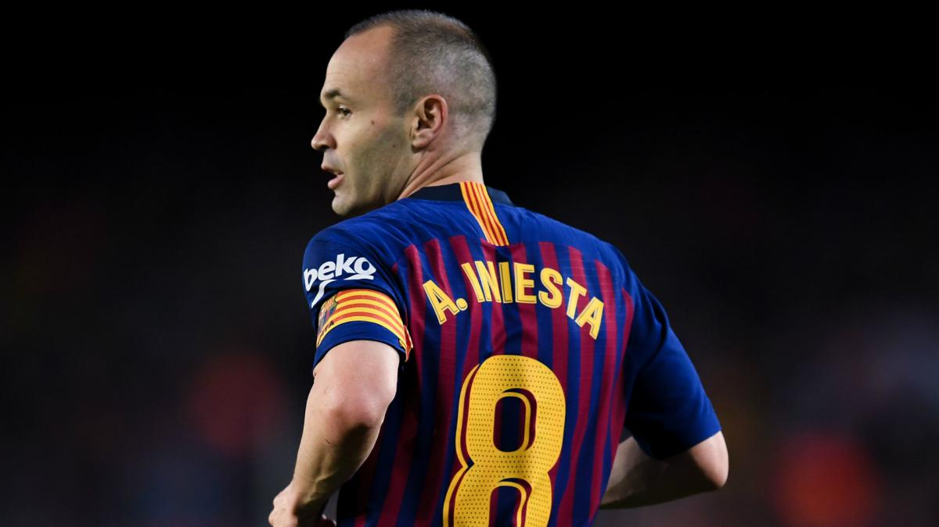
IEDA 3230 presentation
The Trilemma of Iniesta
LEUNG, Hiu Man, NG, Wing Lam , TSE, Kai Yat
Notes:
Imagine…..Where are we going? What is it? When will we arrive?
A parent can never really be on vacation kids.
"Going on vacation" generally implies taking a break from the hustle and bustle of everyday life. Yet, little ones do not pause their hustling and bustling when they're on vacation. They still poop their pants, wipe boogers on their parents' sleeves and grind goldfish crackers into every crevice they can find. Even at the beach. Even in hotel rooms. Even at the most magical place on Earth.
https://mom.me/toddler/29232-how-not-hate-your-vacation-small-children/
https://www.huffpost.com/entry/10-reasons-why-family-vac_n_10112430?guccounter=1

Slide 2
Who is Andres Iniesta?
Spanish footballer
Born in 1984 (currently 35)
In 2001, started senior football career at Barcelona (aged 17)
In 2018, signed for Japanese club Vissel Kobe -> contract expires by the end of 2021
Currently holds two degrees from Ramon Llull University, Spain: one in biology and one in sports science
The question is: what should Iniesta work as after he retires?

Slide 3
Objectives
To find out the best choice to maximize Iniesta’s income by comparing various career choices in his life

Slide 4
3 choices for him
Early life choice | Retired life choice
biologist
football player | biologist
football player | football manager
1.
2.
3.

Slide 5
Methodology
1. Compare the income of the early life pathway by PW (2001-2021)
(age 17 - 37)
2. Compare the income of the retired life pathway by PW (2021-2044)
(age 37 - 60)
3. Compare the income of the lifelong pathway by PW (2001-2044)
(age 17 - 60)

Slide 6
Data Collection
1. Income of typical biologist of a biology master
2. Current income of Andres Iniesta as a footballer
3. Income of football manager or football-related work (manager)

Slide 7
Assumptions
1. Retirement year on football player (2021)
2. Retirement year on whole lifetime (2044) (age at 60)
3. Future employment is continuous (He does not lose his job)
4. His salary increases in a uniform gradient
5. For the early-life pathway analysis, he obtained his degrees at the age of 22 and started to be a biologist straight after.
6. i% is constant = average inflation rate of Spain (2001-2019)

Slide 8
Pathway 1- biologist
Biologist
Current income | €6,000(with Master Degree)
Increasing rate due to experience | 5.178%
Increasing rate due to time | 1.065%
Sum of present worth | €7,083,707

Slide 9
Pathway 2- football player + biologist
 | Biologist | Football player | Total
Current income | €6,000 (with Master’s Degree) | €30,000,000
Increasing rate due to experience | 5.178% | 22% (geometric gradient)
Increasing rate due to time | 1.065%
Sum of present worth | €2,535,265 | €266,710,000 | €269,245,265

Slide 10
Pathway 3- football player + football manager
 | Football Manager | Football player | Total
Current income | €3,000,000 (after 20 years’ experience) | €30,000,000
Increasing rate due to experience | 5.178% | 22% (geometric gradient)
Increasing rate due to time | 2.0791%
Sum of present worth | €68821910 | €266,710,000 | €335,531,910

Slide 11
Comparison
 | Pathway 1 (Biologist) | Pathway 2 (Football player+Biologist) | Pathway 3 (Football player+Football manager)
Present worth | €7,083,707 | €269,245,265 | €335,531,910
Ranking (1 Most 3 least) | 3 | 2 | 1

Slide 12
Conclusion
1. For the early years, he made a good choice on being a football player
2. For the late times, he should be a football manager instead of being a biologist.

Slide 13
Q&A

